Slide 1
BIT 245
RDBMS With SQL
Sushil Bhattarai
sushil.bhattarai@texascollege.edu.np
Lincoln University College, CN 1221

Slide 2
Retrieving data

Slide 3
Data Types
Data type | Storage | Description
bigint | 8 bytes | Integer from -2^63 (-9 223 372 036 854 775 808) to 2^63-1 (9 223 372 036 854 775 807)
int | 4 | Integer from -2^31 (-2 147 483 648) to 2^31-1 (2 147 483 647)
smallint | 2 | Integer from -2^15 (-32 768) to 2^15-1 (32 767)
tinyint | 1 | Integer from 0 to 255
bit | 1 bit | Integer 0 or 1.
decimal(precision, scale) | 5-17 depending on p and s | Numeric data type with fixed precision and scale (accuracy 1-38, 18 by default and scale 0-p, 0 by default).
datetime | 8 | Data type representing date and time from 1.1.1753 to 31.12.9999 with precision about 3 ms. Values are rounded to .000, .003 and .007.
smalldatetime | 4 | Data type representing date and time from 1.1.1900 to 6.6.2079 with precision of 1 minute. Values up to 29.998 are rounded down and values from 29.999 are rounded down to the nearest minute.
char | n | Text string of fixed length (maximum length of 8000 chars).
varchar | n | Text string of variable length (maximum length of 8000 chars)
Numeric Data Type
Date Time Data Type
Alpha Numeric Data Type

Slide 4
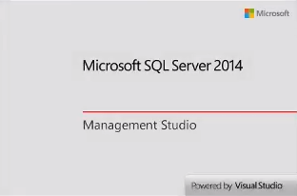
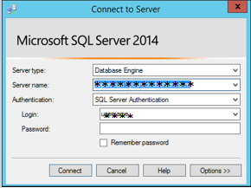
MSSQL Server Overview

Slide 5
System Databases
Master
Contains all of the system level information for SQL Server – all of the logins, linked servers, endpoints, and other system-wide configuration settings
Stores information about the other databases
SQL Server cannot start if Master db is not present
Model
Must always exist on a SQL Server system
Entire contents of the database including database options, are copied to the new database
Msdb
Used by the SQL Server Agent, database mails and jobs
Holds history when each database and filegroup was last backed up
Tempdb
global resource that is available to all users connected to the instance
Re-created every time the SQL Server service is started
Stores the intermediate results and temporary data
Vital for SQL Server performance

Slide 6
Architecture of MSSQL Databases
Data Files
Primary Data Files
All data in the database are stored in the Primary Data Files
Only one primary data file for a database
Extension .mdf, i.e. Master Database File
Secondary Data Files
used to spread data across multiple disks
Can use multiple Secondary Data Files
Extension .ndf
Log Files
useful for the database recovery
Can have one or more log files
store the transaction information (insert, update, delete etc.)
extension of log data file is .ldf

Slide 7
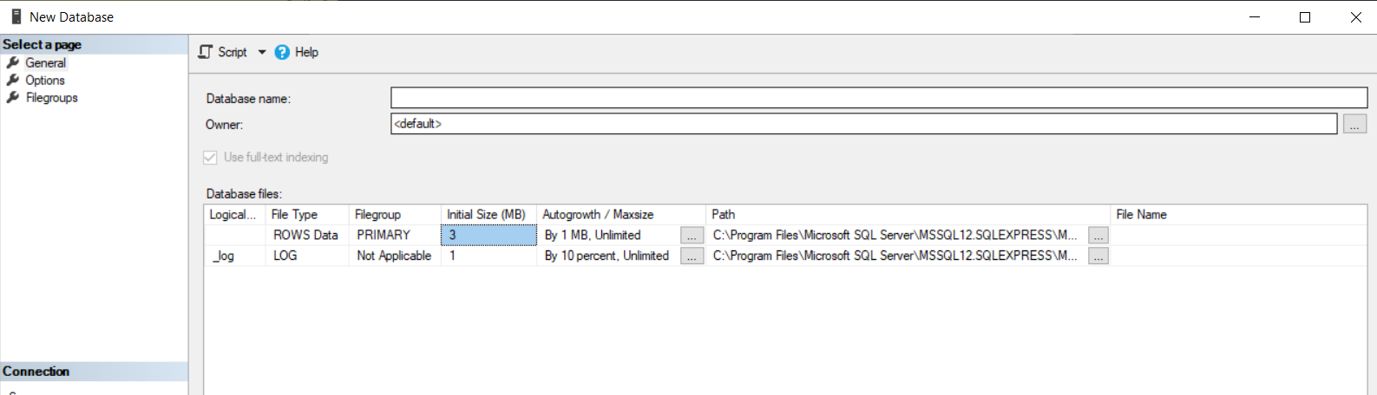
MSSQL Data Files

Slide 8
SQL
Set of commands/Instructions.
To access and manipulate data and databases.
standard language for Relational Database System; enables user to create, read, update and delete relational databases and tables.
not case sensitive.
SQL depends on tuple relational calculus and relational algebra.

Slide 9
Create tables in MSSQL
Create a Table named “Laptop” to store the details of Laptops bought by a Retailer. The table should store the details like Brand(Not Null), Model(Not Null and Unique), Type(Gaming, office, home use ,etc. and Not Null), Price(>0), Manufactured date(Default to Today’s date), Warranty Period(in months from Manufactured date), etc.
CREATE TABLE Laptop(
Id INT PRIMARY KEY IDENTITY(1,1),
Brand VARCHAR(100) NOT NULL,
Model VARCHAR(100) NOT NULL UNIQUE,
Type VARCHAR(100) NOT NULL,
Price DECIMAL (10,2) CHECK(Price>0),
ManufacturedDate DATE DEFAULT GETDATE(),
Warranty INT
)

Slide 10
Create tables in MSSQL
Create a table “Citizen” to store data of Citizens(similar to the data in a Citizenship)
Create a table named “Contact” to store contact details of persons(similar to a Phone Book in a Smart Phone). The table should be able to check if the length of the entered phone number is greater or equal to 10.

Slide 11
Create table Contact (
Id int Primary Key Identity(1,1)
FirstName VARCHAR(200) NOT NULL,
LastName VARCHAR(200) NOT NULL,
Mobile VARCHAR(50) NOT NULL,
HomePhoneNumber VARCHAR(50),
WorkPhoneNumber VARCHAR(50),
Address VARCHAR(200),
DOB DATE,
Email VARCHAR(100)
)
Insert into Contact(FirstName , LastName , Mobile )
Values(‘ram’,’kumar’,’123’)

Slide 12
Insert into Table
SELECT * FROM Product;
-- Insert data in table Product
Insert Into Product(
Brand,
ProductName,
ProductType,
Price,
ManufacturedDate,
ExpiryDate,
BatchNo
)
VALUES(
'Chaudhary',
'Wai Wai',
'Noodles',
20,
'2021/01/01',
'2021/08/01',
185
)
Insert 10 more records in table Product

Slide 13
Query Exercise
Insert records of 10 people in table “Citizen”.
Select any 5 of the records from table “Citizen”
Select only 2 of the records from table “Citizen” eldest first.
Select only 5 of the records from table “Citizen” youngest first.
Select only citizens born in “Kathmandu”.
Show only the Names of Citizens.
Show only the Name and Birth Places of each Citizen.

Slide 14
Query Exercise
Show the list of Citizens that were born later than 2001-01-01.
Show the list of Citizens that were born between 2001-01-01 and 2005-01-01.
Show the list of Citizens that were born in Pokhara and Kathmandu(Use IN).

Slide 15
Query Exercise
Insert records of 10 people in table “Contact”.
Select any 3 persons from table “Contact” whose First Name starts with ‘a’.
Select 2 persons from table “Contact” who have gmail accounts.
Select any 5 persons from table “Contact” whose Last Name starts with ‘s’.
Show only 5 “Name” and “Phone Number” from table “Contact” and sort them alphabetically.
Show only 2 records from table “Contact” that have valid values for Work.
Show only the contact details with no data for “DOB”
Show only the “Name” and “DOB” of each records that have valid DOB.
Show only the Name and Age of each records.

Slide 16
SQL
Eg:
Create table Student(
Id int Primary key identity(1,1) NOT NULL,
FirstName varchar(255) NOT NULL,
LastName varchar(255) NOT NULL,
DOB date,
Weight Decimal(10,2),
IsCR Bit
)

Slide 17
SQL
Eg:
Insert into table
Select * from table
Select column names
Order by
where
Like
Update
Delete

Slide 18
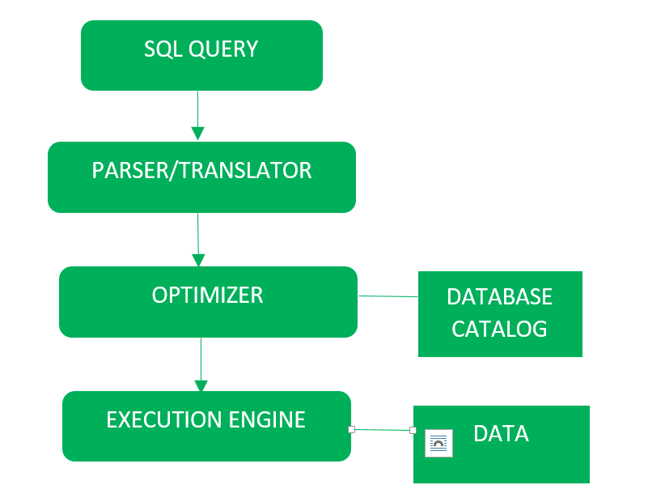
Query Processing
Parser:
Syntax check and Semantic check
(e.g.: checks if query contains
table name that does not exist)
Optimizer:
Query execution plan(way to
implement the SQL request ) are
examined and most efficient plan
is selected.
The database catalog stores the
execution plans and optimizer passes the lowest cost plan for execution.
Execution Engine:
Finally, run the query and display the results.

Slide 19
Types of SQL Commands
DDL(Data Definition Language)
Used to create and modify the structure of database objects in database
CREATE – Creates objects in the database ALTER – Alters objects of the database DROP – Deletes objects of the database TRUNCATE – Deletes all records from a table and resets table identity to initial value.
DML(Data Manipulation Language)
Read, store, modify, delete, insert and update data in database
SELECT - Reads data from a table INSERT - Inserts data into a table UPDATE - Updates existing data into a table DELETE - Deletes records from a table
DCL(Data Control Language)
used to create roles, permissions and control access to database
GRANT – Gives user's access privileges to database REVOKE – Withdraws user's access privileges

Slide 20
Operators
Comparision
Comparison operators compares whether two expressions are the same
Operator | Meaning
= | Equal to
> | Greater than
< | Less than
>= | Greater than or equal to
<= | Less than or equal to
<> | Not equal to

Slide 21
Operators
Logical
Operator | Meaning
AND | TRUE if both Boolean expressions are TRUE.
OR | TRUE if either Boolean expression is TRUE.
BETWEEN | TRUE if the operand is within a range.
EXISTS | TRUE if a subquery contains any rows.
IN | TRUE if the operand is equal to one of a list of expressions.
LIKE | TRUE if the operand matches a pattern.
NOT | Reverses the value of any other Boolean operator.
Operator | Meaning
= | Equal to
> | Greater than
< | Less than
>= | Greater than or equal to
<= | Less than or equal to
<> | Not equal to

Slide 22
Operators
Arithmetic
Operator | Meaning
+ | Addition
- | Subtraction
* | Multiplication
/ | Division
% (Modulo) | Returns the integer remainder of a division. For example, 5 % 3 = 2 because the remainder of 5 divided by 3 is 2.

Slide 23
Operators
Compound
Operator | Action
+= | Adds some amount to the original value and sets the original value to the result.
-= | Subtracts some amount from the original value and sets the original value to the result.
*= | Multiplies by an amount and sets the original value to the result.
/= | Divides by an amount and sets the original value to the result.
%= | Divides by an amount and sets the original value to the modulo.
Find yourself what these operators do

Slide 24
Constraints
SQL constraints are used to specify rules for the data in a table. These can be specified when tables are created or after it has been created.
Constraints are used to limit the type of data that can go into a table. This ensures the accuracy and reliability of the data in the table. If there is any violation between the constraint and the data action, the action is aborted.
Common Constraints:
NOT NULL - Ensures that a column cannot have a NULL value
UNIQUE - Ensures that all values in a column are different
PRIMARY KEY - A combination of a NOT NULL and UNIQUE. Uniquely identifies each row in a table
FOREIGN KEY - Uniquely identifies a row/record in another table
CHECK - Ensures that all values in a column satisfies a specific condition
DEFAULT - Sets a default value for a column when no value is specified
Constraints

Slide 25
NOT NULL
This enforces a field to always contain a value, which means that you cannot insert a new record, or update a record without adding a value to this field.
When creating a table
CREATE TABLE Student( ID INT NOT NULL, FirstName VARCHAR(255) NOT NULL, LastName VARCHAR (255) NOT NULL, Age INT );
If table has been already created
ALTER TABLE Person
ALTER COLUMN Age INT NOT NULL;
To remove the constraint
ALTER TABLE Person
ALTER COLUMN Age INT NULL;
25
Constraints

Slide 26
UNIQUE Constraint
Unique Constraint ensures all values in a column are different.
When creating a table
CREATE TABLE Teacher( ID INT NOT NULL, FirstName VARCHAR(255) NOT NULL, LastName VARCHAR(255) NOT NULL, Phone VARCHAR(255) UNIQUE );
OR
CREATE TABLE Teacher( ID INT NOT NULL, FirstName VARCHAR(255) NOT NULL, LastName VARCHAR(255) NOT NULL, Phone VARCHAR(255),
CONSTRAINT UK_Phone UNIQUE (Phone) );
If table has been already created
ALTER TABLE Student
ADD CONSTRAINT UK_Phone UNIQUE(Phone);
To remove the constraint
ALTER TABLE Student
DROP CONSTRAINT UK_Phone;
26
Constraints

Slide 27
PRIMARY KEY Constraint
Primary keys uniquely identifies each record in a table.
A Primary key must contain UNIQUE values, and cannot contain NULL values.
A table can have only one primary key, which may consist of single or multiple fields.
When creating a table
CREATE TABLE Person(
ID INT PRIMARY KEY NOT NULL,
FirstName VARCHAR(255) NOT NULL,
LastName VARCHAR(255) NOT NULL,
Age INT
);
If table has been already created
ALTER TABLE Person
ADD CONSTRAINT PK_ID PRIMARY KEY (ID);
To remove the constraint
ALTER TABLE Person
DROP CONSTRAINT PK_ID;
27
Constraints

Slide 28
FOREIGN KEY Constraint
A Foreign Key is a key used to link two tables together.
A Foreign Key is a field in one table that refers to the PRIMARY KEY in another table.
When creating a table
CREATE TABLE Orders (
ID INT PRIMARY KEY NOT NULL,
OrderNumber INT NOT NULL,
PersonID INT FOREIGN KEY REFERENCES Person(ID)
);
OR
CREATE TABLE Orders (
ID INT PRIMARY KEY NOT NULL,
OrderNumber INT NOT NULL,
PersonID INT,
CONSTRAINT FK_PersonOrders FOREIGN KEY (PersonID)REFERENCES Person(ID)
);
If table has been already created
ALTER TABLE Orders
ADD CONSTRAINT FK_PersonOrders FOREIGN KEY (PersonID) REFERENCES Person(ID);
To remove the constraint
ALTER TABLE Orders
DROP CONSTRAINT FK_PersonOrders;
28
Constraints

Slide 29
CHECK Constraint
The CHECK constraint is used to limit the value range that can be placed in a column.
When creating a table
CREATE TABLE Customer(
ID INT NOT NULL,
FirstName varchar(255) NOT NULL,
LastName varchar(255) NOT NULL,
Age INT CHECK (Age>=18)
);
If table has been already created
ALTER TABLE Person
ADD CONSTRAINT CHECK_PersonAge CHECK (Age>=18);
To remove the constraint
ALTER TABLE Person
DROP CONSTRAINT CHECK_PersonAge;
29
Constraints

Slide 30
DEFAULT Constraint
The DEFAULT constraint is used to provide a default value for a column.
The default value will be added to the new records if no value is specified.
When creating a table
CREATE TABLE Students(
ID INT NOT NULL,
FirstName varchar(255) NOT NULL,
LastName varchar(255) NOT NULL,
Age INT,
City VARCHAR(255) DEFAULT 'Kathmandu‘
);
Or
CREATE TABLE Students(
ID INT NOT NULL,
FirstName varchar(255) NOT NULL,
LastName varchar(255) NOT NULL,
Age INT,
City VARCHAR(255) CONSTRAINT DEFAULT_City DEFAULT 'Kathmandu‘
);
If table has been already created
ALTER TABLE Person
ADD CONSTRAINT DEFAULT_City DEFAULT 'Kathmandu' FOR City;
To remove the constraint
ALTER TABLE Person
DROP CONSTRAINT DEFAULT_City;
30
Constraints

Slide 31
IDENTITY COLUMN
IDENTITY column is used to automatically generate key values based on a provided starting point and increment.
Often this is the primary key.
CREATE TABLE Student( ID int PRIMARY KEY IDENTITY(1,1) , LastName varchar(255) NOT NULL, FirstName varchar(255), Age int );
Insert into table
INSERT INTO Persons (FirstName,LastName) VALUES (‘Ram’,’Kumar');
31
Identity Column

Slide 32
Assignment
1. Create a Table named MobileNumber to store Person’s Name and Mobile Numbers. The table should be able to check if the length of the entered phone number is greater or equal to 10.
Insert into MobileNumber (FirstName, LastName, MobileNumber)
Values(‘Ram’, ’Kumar’, ’1234’)
Insert into MobileNumber (FirstName, LastName, MobileNumber)
Values(‘Shyam’, ’Kumar’, ‘1234567890’)
2. Create a Table named Payment to store the payment records in a store. The table should contain columns Product, Price and date of payment. The table should check if the price is greater than 0. And the default date for date of payment should be today’s date.
Insert into Payment(Product, Price, PaymentDate)
Values(‘Book’, 0.1, ‘2020-01-01’)
Insert into Payment(Product, Price)
Values(‘Book’, 0.01)

Slide 33
Aggregate Functions
Aggregate functions perform a calculation on a set of values and return a single value.
Common Aggregate Functions are:
AVG – calculates the average of a set of values.
COUNT – counts rows in a specified set of values.
MIN – gets the minimum value in a set of values.
MAX – gets the maximum value in a set of values.
SUM – calculates the sum of values.
33
Aggregate Function

Slide 34
Aggregate Function Examples
Average
SELECT AVG(UnitPrice) Average_Unitprice
FROM Product
WHERE SupplierId=20
Count
SELECT COUNT(*) Count_Product
FROM Product
WHERE SupplierId=20
Min and Max
SELECT MIN(UnitPrice) Min_Unitprice, MAX(UnitPrice)Max_UnitPrice
FROM Product
WHERE SupplierId=20
Sum
SELECT SUM(UnitPrice) Total_Unitprice
FROM Product
WHERE SupplierId=20
34
Aggregate Function

Slide 35
Group By
The GROUP BY clause denotes that rows should be grouped according to the columns in the select statement.
GROUP BY must be specified when there are columns along with the aggregate functions in the SELECT statement.
SELECT Column1, Column2, ... Column_n,
aggregate_function (aggregate_expression)
FROM table
[WHERE conditions]
GROUP BY Column1, Column2, ... Column_n
Example
SELECT FirstName, LastName,
AVG(Age) Average_Age
FROM Person
GROUP BY FirstName, LastName
35
Some SQL Clauses

Slide 36
Having
The Having clause is Used to specify conditions on Aggregate Functions.
This is used instead of ‘Where’ when Aggregate Functions are used.
SELECT column_name(s) FROM table_name [WHERE condition] GROUP BY column_name(s) HAVING condition;
Example
SELECT FirstName, LastName, AVG(Age) Average_Age
FROM Person
GROUP BY FirstName, LastName
HAVING AVG(Age)>=18
36
Some SQL Clauses

Slide 37
Exercise
Write a SQL statement to find the maximum price of each brand of laptops.
Write a SQL statement to find the minimum price of each brand of laptops. List the brands if the minimum price more than 40000.
Write a SQL statement to find the average price of each brand only if the average price is greater than 50000.
Write a SQL statement to find the number of laptops of each brand. List the brands that have more than 5 laptops.

Slide 38
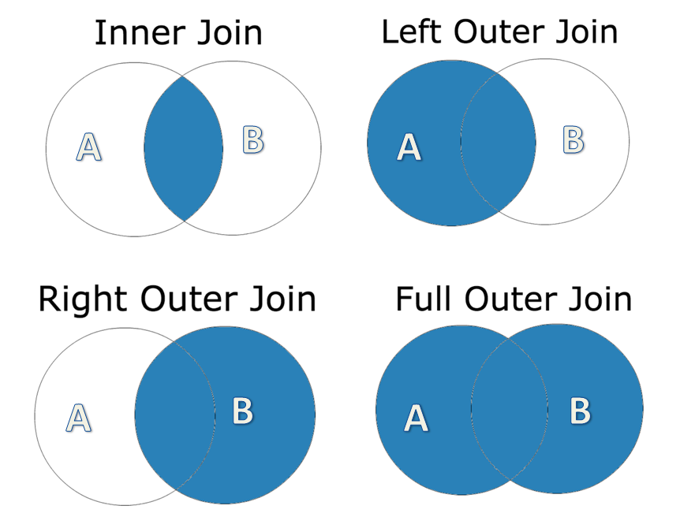
JOINS
Joins are used when data from 2/more tables need to be extracted.
Types of JOIN:
INNER JOIN
LEFT OUTER JOIN
RIGHT OUTER JOIN
FULL OUTER JOIN
38
Joins

Slide 39
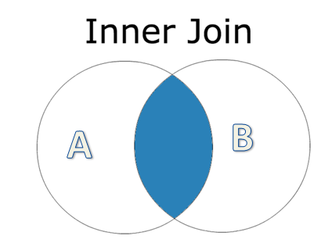
INNER JOIN
Most common type of join
Returns all rows if condition is met.
SELECT columns
FROM table1 t1
INNER JOIN table2 t2
ON t1.column = t2.column;
Example
SELECT C.FirstName, C.LastName, O.totalamount
FROM [Order] O
INNER JOIN Customer C ON C.id=O.CustomerId
SELECT C.FirstName, C.LastName, SUM(O.totalamount) totalamount
FROM [Order] O
INNER JOIN Customer C ON C.id=O.CustomerId
GROUP BY C.FirstName, C.LastName
39
Joins

Slide 40
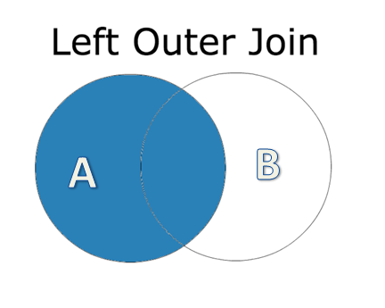
LEFT OUTER JOIN
This type of join returns all rows from the LEFT-hand table specified in the condition and only those rows from the RIGHT-hand table where the join condition is met.
SELECT columns
FROM table1 t1
LEFT OUTER JOIN table2 t2
ON t1.column = t2.column;
Example
SELECT C.FirstName, C.LastName, O.OrderNumber, O.TotalAmount
FROM Customer C
LEFT JOIN [Order] O
ON O.CustomerId = C.Id
40
Joins

Slide 41
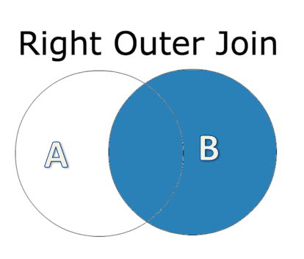
RIGHT OUTER JOIN
This type of join returns all rows from the RIGHT-hand table specified in the condition and only those rows from the LEFT-hand table where the join condition is met.
SELECT columns
FROM table1 t1
RIGHT OUTER JOIN table2 t2
ON t1.column = t2.column;
Example
SELECT C.FirstName, C.LastName, O.OrderNumber, O.TotalAmount
FROM [Order] O
RIGHT JOIN Customer C
ON C.Id = O.CustomerId
41
Joins

Slide 42
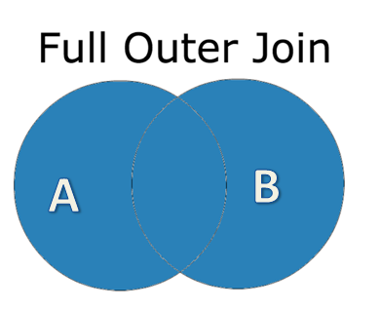
FULL OUTER JOIN
This join returns all rows from the LEFT-hand table and RIGHT-hand table with nulls in place where the join condition is not met.
SELECT columns
FROM table1 t1
FULL OUTER JOIN table2 t2
ON t1.column = t2.column;
Example
SELECT *
FROM [Order] O
FULL OUTER JOIN Customer C
ON C.Id = O.CustomerId
SELECT C.FirstName, C.LastName, C.Country,
S.Country, S.CompanyName
FROM Customer C
FULL JOIN Supplier S
ON C.Country = S.Country
42
Joins

Slide 43
Query Exercises on Joins
Create a table named Shipment to store the details of shipped laptops. The table should contain the columns LaptopID(FK referencing the PK of Laptop Table), Country, Shipped Date, Shipping charges.
Insert any 5 records to show the laptops have been shipped to different countries.
Show the list of Brands that have already been shipped.
Show the list of Brands and the countries that are shipped to. If the laptops are not shipped yet, show “Not Shipped Yet”.

Slide 44
Query Exercises on Joins
Create a table named TuitionFee to store the details of Fee paid by Student. The table should contain the columns StudentID(FK referencing the PK of Student Table), Amount, Description and DateofPayment. You should be able to store those amounts that are greater than Zero(use Check). The default value to DateofPayment should be today’s date.
Insert at least 5 records to show the fee paid by students.
Create a table named Project to store the details of Project. The table should contain StudentId (FK referencing the PK of Student Table), Project, Department, Supervisor, StartDate and EndDate.
Insert at least 5 records to show projects of each Students.

Slide 45
Query Exercises on Joins
Show the list of Students that have paid fee.
Show the list of Students that are involved in a Project.
Show the list of Students and total amount they have paid. The student with highest paying fee should show on top and lowest on bottom.
Show the list of Students and Total Fee they have paid only if the total fee is greater than 4000.
Show the list of Students and number of Projects they are involved in.
Show number of students involved in the each project.
Show number of students involved in the each project only if multiple Students(Number of Students>1) are involved.
Show the list of Students that have paid fee and are involved in a Project.

Slide 46
Query Exercises on Joins
Show the list of Students and Total amount they have paid. Show 0 if they have not paid.
Show the list of Students that have not paid Fee.
Show the list of Students that are involved in a Project. If not involved show 'Not Involved' in Project Name.
Show the list of Students that are not involved in any Project.
Show the list of Students that have paid Fee but are not involved in any Project.
Show the list of Students that are involved in a Project but have not Paid any Fee.
Show the list of Students and amount they have paid. The student with highest paying fee should show on top and lowest on bottom.
Show the list of Students and amount they have paid only if the total fee is greater than 4000.
Show the list of Students and number of Projects they are involved in.
Show number of students involved in the each project.
Show number of students involved in the each project only if the multiple Students(Number of Students>1) are involved.
Show the list of Students that have paid fee and are involved in a Project

Slide 47
ROW_NUMBER()
Write a query to find Duplicate Rows from the table Student.
Select * From (
SELECT
[FirstName]
,[LastName]
,[BirthDate]
,[Gender]
,[Class]
,[Point]
,ROW_NUMBER() OVER(PARTITION BY [FirstName], [LastName], [BirthDate], [Gender], [Class],[Point] ORDER BY [FirstName]) sn
FROM [Student]
) b
Where b.sn>1

